Slide 1

Stock Analyser
Group Member: An Yueran, Jia Xiaorui, Zhu Huijin

Slide 2
1.Introduction
Existing problem
1. Graph analysis
Stock Analyser
Q1
3. Argument
What problems do our project solve?

Slide 3

2.Problems & Computer Science Solutions
PROBLEMS:
01
The process of getting data can be cumbersome.
02
Too many data sets.
03
Setting image format is a pain.

Slide 4
2.Problems & Computer Science Solutions
SOLUTIONS:
Crawler
Web crawling is the process of collecting and parsing raw data from the Web.
Concurrency
Concurrency means multiple computations are happening at the same time.a
Computer
Concepts
Data processing
Pandas
Plot
Matplotlib

Slide 5
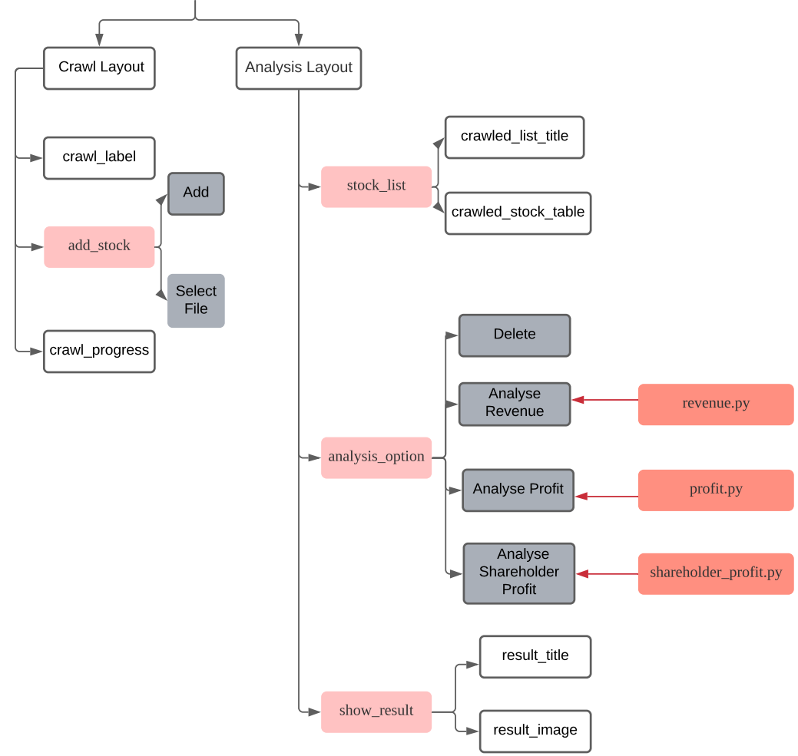
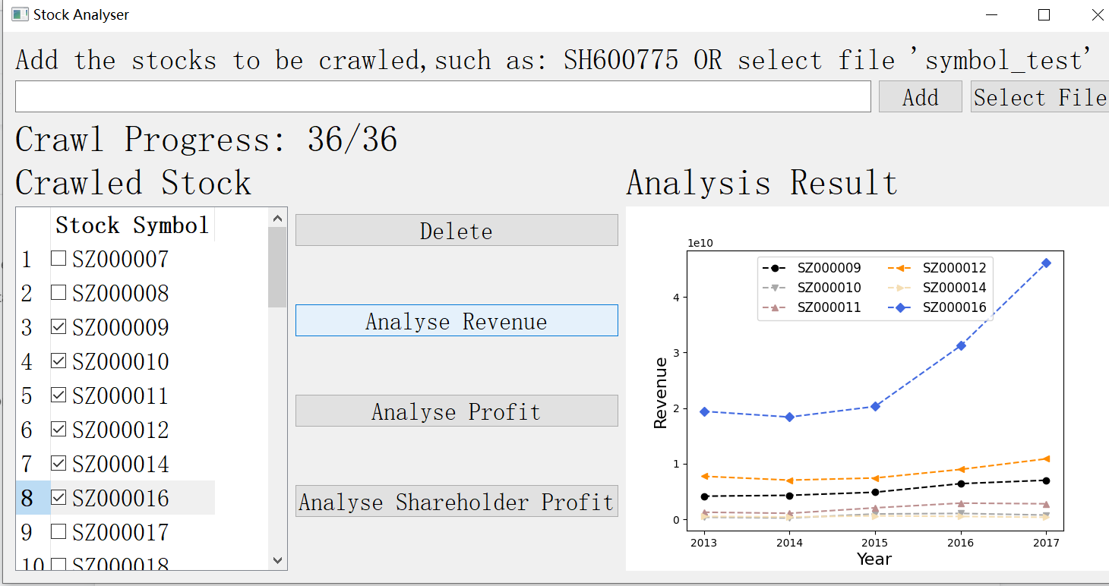
3.Structure

Slide 6
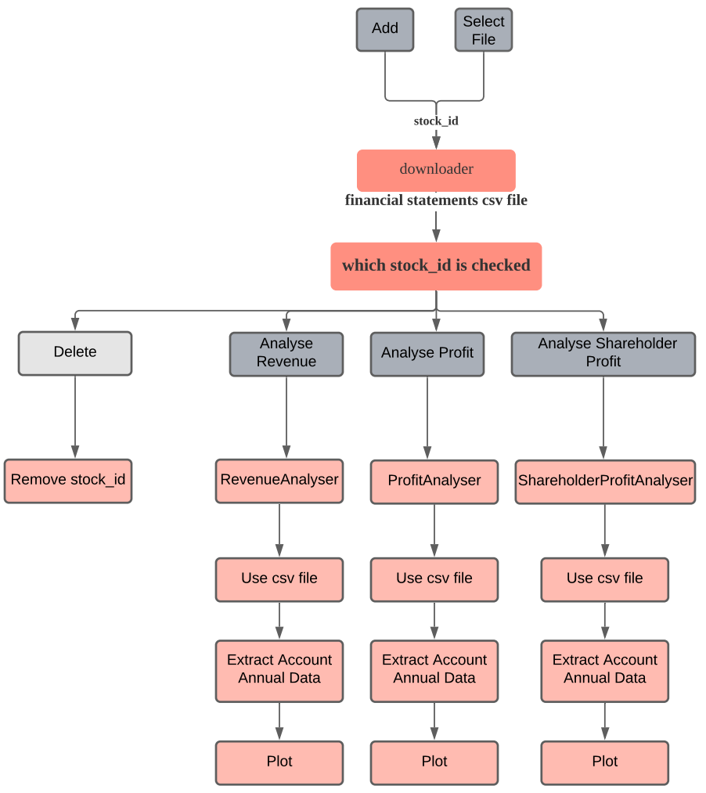
4.Flowchart

Slide 7
5.Suggestions
a)
Latest financial data update issue
Suggestions
b)
Data volume limitation problem

Slide 8
Thank You

